Slide 1
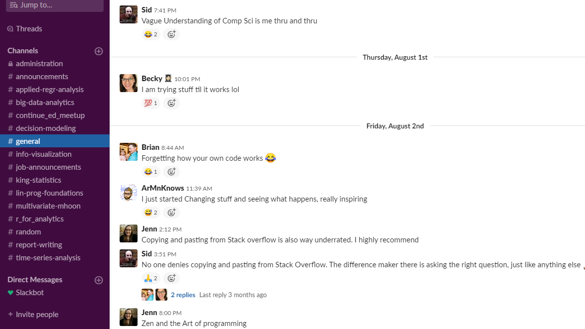
Sentiment Analysis of the MSDA Slack
https://uhd-msda.slack.com/ Brian Chambers Fall ‘19
Faculty Advisor – Dr. Shastri
December 4, 2019

Slide 2
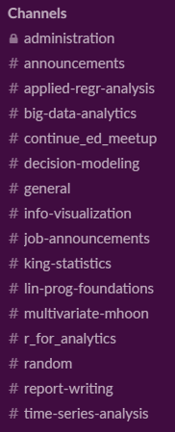

What is Slack?
Collection
Data Preparation
Data Exploration
Data Analysis
- Slack is a chatroom like service, designed to replace email and encourage communication and collaboration.
- Started in December 2017.
- Broken up into sub-channels that each have a specific purpose.
- Class specific, general purpose, and private channels.
- 175 Registered users, 62 are included in data.
Conclusions

Slide 3
Motivation
Collection
Data Preparation
Data Exploration
Data Analysis
- I began the channel in 2017 to provide students with a better way to communicate.
- I found the email system and lacking and had been using Slack outside of school.
- I spent a significant amount of time trying to convince students to join.
- I wanted to analyze the sentiment of messages posted in our Slack channel to attempt to infer useful conclusions from the data.
Conclusions

Slide 4



Resources
Collection
Data Preparation
Data Exploration
Data Analysis
Conclusions
V.A.D.E.R.

Slide 5
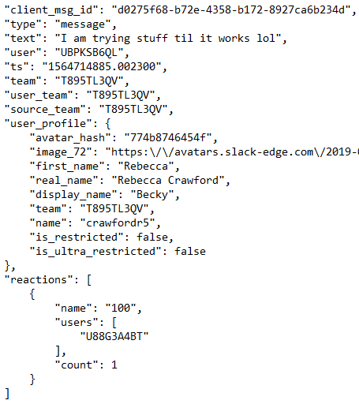
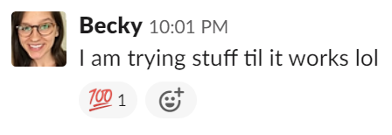
Collection
Data Preparation
Getting the Data
Data Exploration
Data Analysis
- Slack channel in operation since December 3, 2017, two years of data.
- Data exports as several hundred .json files with a file for each day a message is posted.
Conclusions
Notes:
Talk about weekly active vs posting users, possible future frequency analysis.

Slide 6
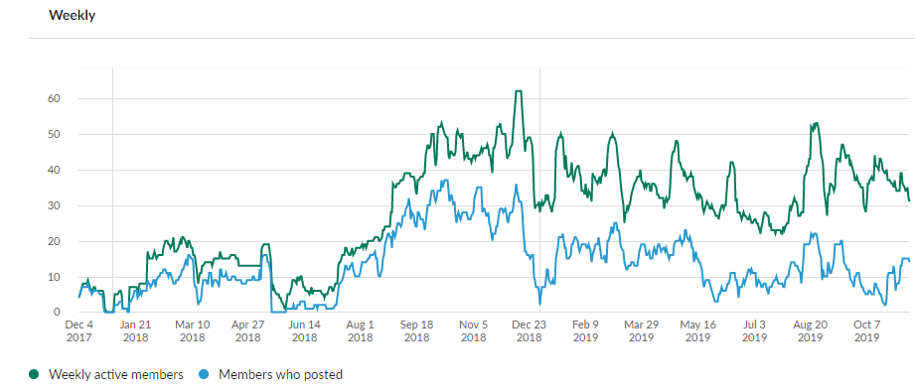
Collection
Data Preparation
Interesting Observations
Data Exploration
Data Analysis
- Started slow in first semester
- Spikes at beginning of semesters
Conclusions
Notes:
Talk about weekly active vs posting users, possible future frequency analysis.

Slide 7

Data Pre-processing: Python vs R
Collection
Data Preparation
Data Exploration
Data Analysis
Conclusions
More flexible
More native text tools
V.A.D.E.R
More knowledge
Faster overall
Notes:
Fix text formatting

Slide 8
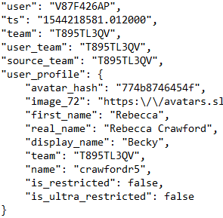
Data Pre-processing: Anonymization
Collection
Data Preparation
Data Exploration
Data Analysis
Conclusions
- Removing personally identifiable information
- Remove “user_profile” tree that contains names
- All other places use unique user id
- Don’t break the JSON structure
- Flatten file structure (28 folders to one)
I used a separate script to preprocess the data from Slack and remove all personally identifiable information.

Slide 9
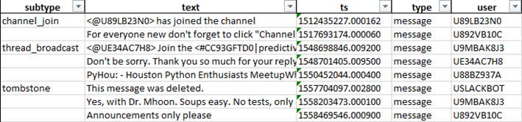
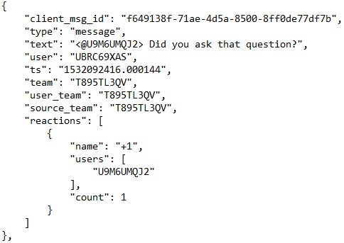
Data Pre-processing: Data Cleaning
Collection
Data Preparation
Data Exploration
Data Analysis
Conclusions
- Read in data from json
- Flattened to 138 columns, 4033 rows.
- Exported data to Excel to get a better idea of what is included.
- Dropped all except 10 columns as not necessary for this project.
A second script was created for the further cleaning needed prior to processing and throughout the scoring process.
Notes:
Add snapshot of the columns I am using

Slide 10


Data Exploration
Collection
Data Preparation
Data Exploration
Data Analysis
Conclusions
- IDLE IDE will not work because of the emojis in the data
- Swapped to Spyder IDE
Issues:
- Converting numeric (UNIX) timestamp to a Date/Time format
- Bits of code mixed in
- Stemming vs. Lemmatizing
- Data is very sparse in places
Notes:
Add snapshot of slack with code mixed in

Slide 11


V.A.D.E.R
Collection
Data Preparation
Data Exploration
Data Analysis
(Valence Aware Dictionary and sEntiment Reasoner)
- Rule-based sentiment analysis engine
- Each word has a score
- Grammatical and syntactical rules modify the score
- Word-order sensitive relationships between terms
- Black box algorithm
- Calculated VADER score creates four values
- Positive - Neutral – Negative – Compound
- Positive + Neutral + Negative = ~1 for each message
- Compound represents the overall sentiment
Certain phrases were incorrectly rated,
“No problem!” = Neg 1 or Comp -.636
Hutto, C.J. & Gilbert, E.E. (2014). VADER: A Parsimonious Rule-based Model for Sentiment Analysis of Social Media Text. Eighth International Conference on Weblogs and Social Media (ICWSM-14). Ann Arbor, MI, June 2014. https://github.com/cjhutto/vaderSentiment
Conclusions
Notes:
“No Problem” 4 occurances

Slide 12
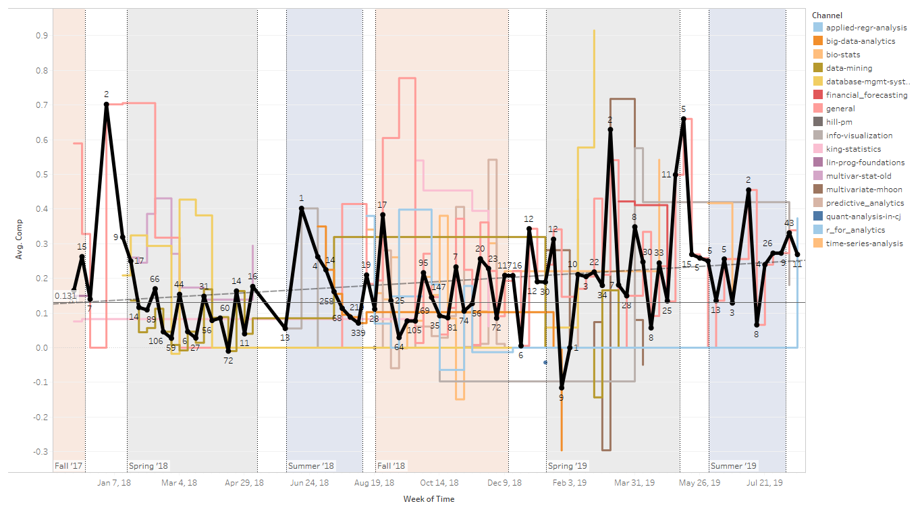
Sentiment Analysis Over Time By Channel and Average
Collection
Data Preparation
Data Exploration
Data Analysis
Conclusions
Spikes Around Holidays

Slide 13
Sentiment Analysis Over Time By Channel and Average
Collection
Data Preparation
Data Exploration
Data Analysis
Less content = more variability
Conclusions

Slide 14
Sentiment Analysis Over Time By Channel and Average
Collection
Data Preparation
Data Exploration
Data Analysis
Conclusions
Trend is expected to continue between .1 and .2 and only vary semester to semester.

Slide 15
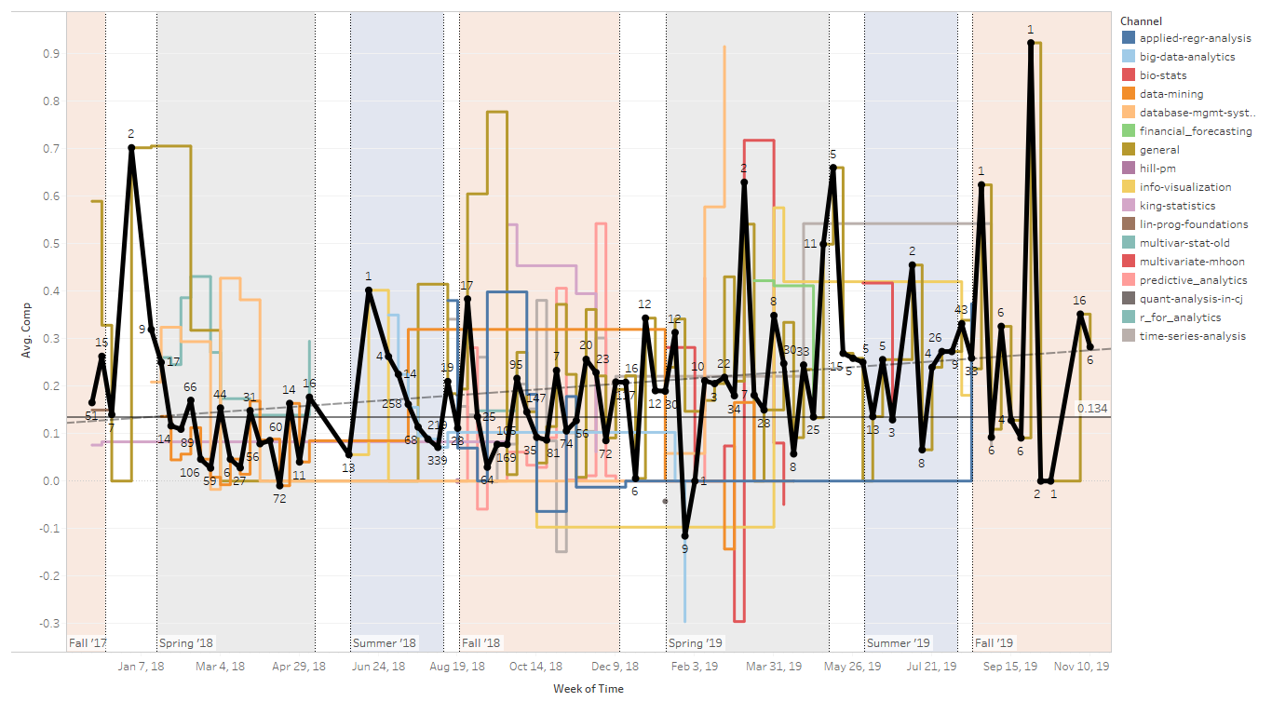
Sentiment Analysis Over Time By Channel and Average (including Fall ‘19)
Collection
Data Preparation
Data Exploration
Data Analysis
Conclusions
During the most recent semester the sentiment continued rising.

Slide 16
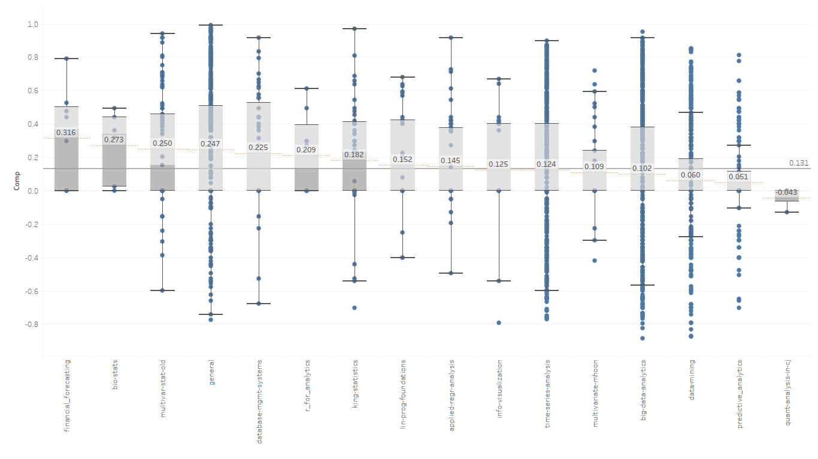
Box-and-Whisker Plot of Compound Score
Collection
Data Preparation
Data Exploration
Data Analysis
Conclusions
8
6
85
565
44
8
39
33
51
26
780
34
901
597
133
3
Notes:
General Channel is a good indicator of overall sentiment add highlighter back in

Slide 17
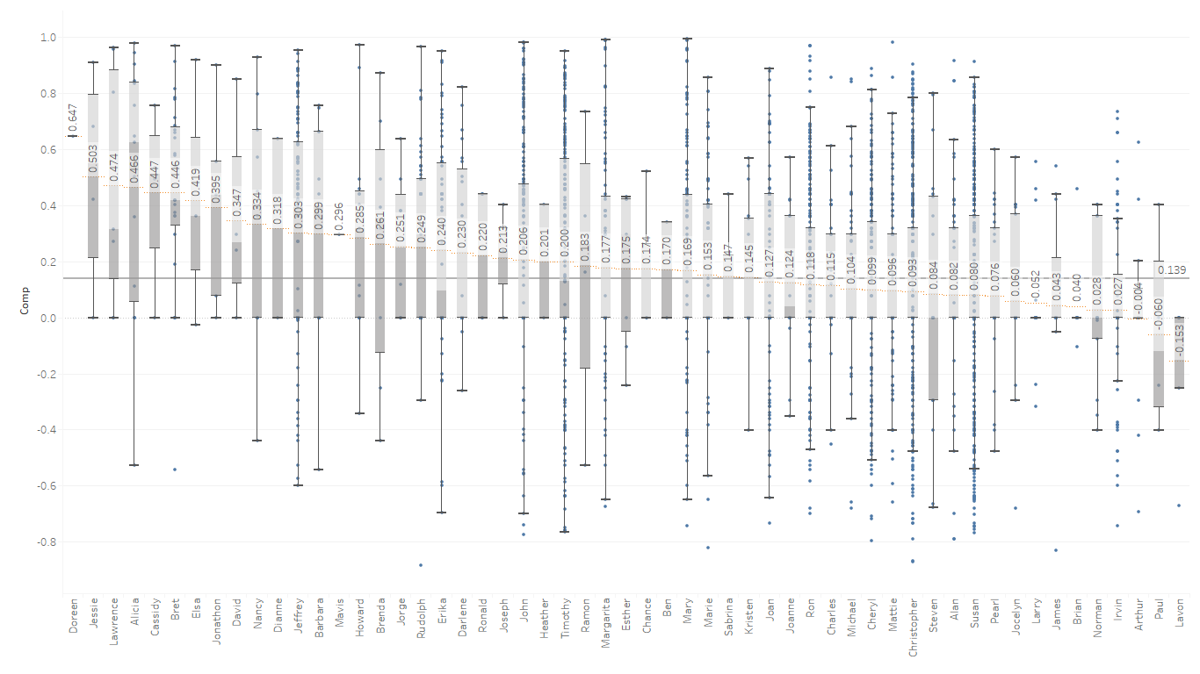
Box-and-Whisker Plot by User Alias
Collection
Data Preparation
Data Exploration
Data Analysis
Conclusions
Names used are randomly generated.

Slide 18
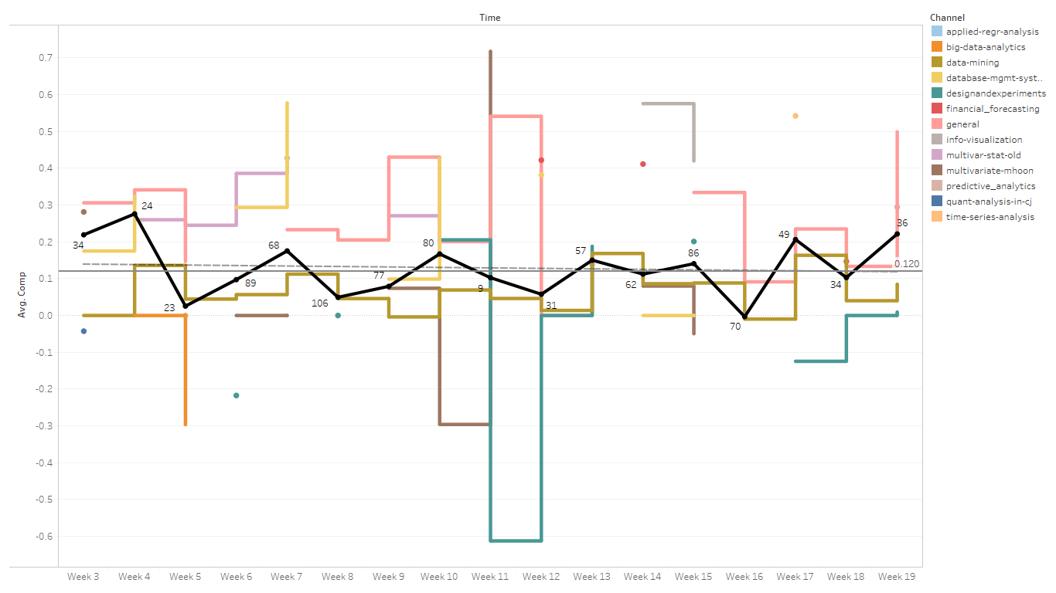
Sentiment Over Spring ’18 & ‘19 Semesters
Collection
Data Preparation
Data Exploration
Data Analysis
Conclusions

Slide 19
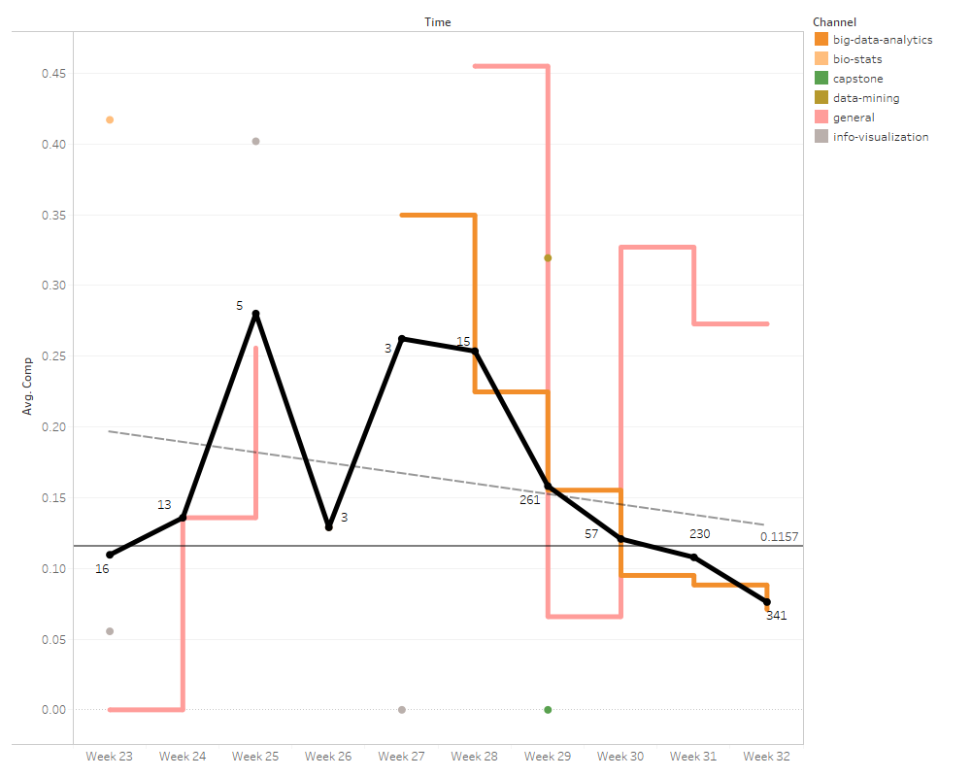
Sentiment Over Summer ’18 & ‘19 Semesters
Collection
Data Preparation
Summer 1
Summer 3
Data Exploration
Data Analysis
Conclusions

Slide 20
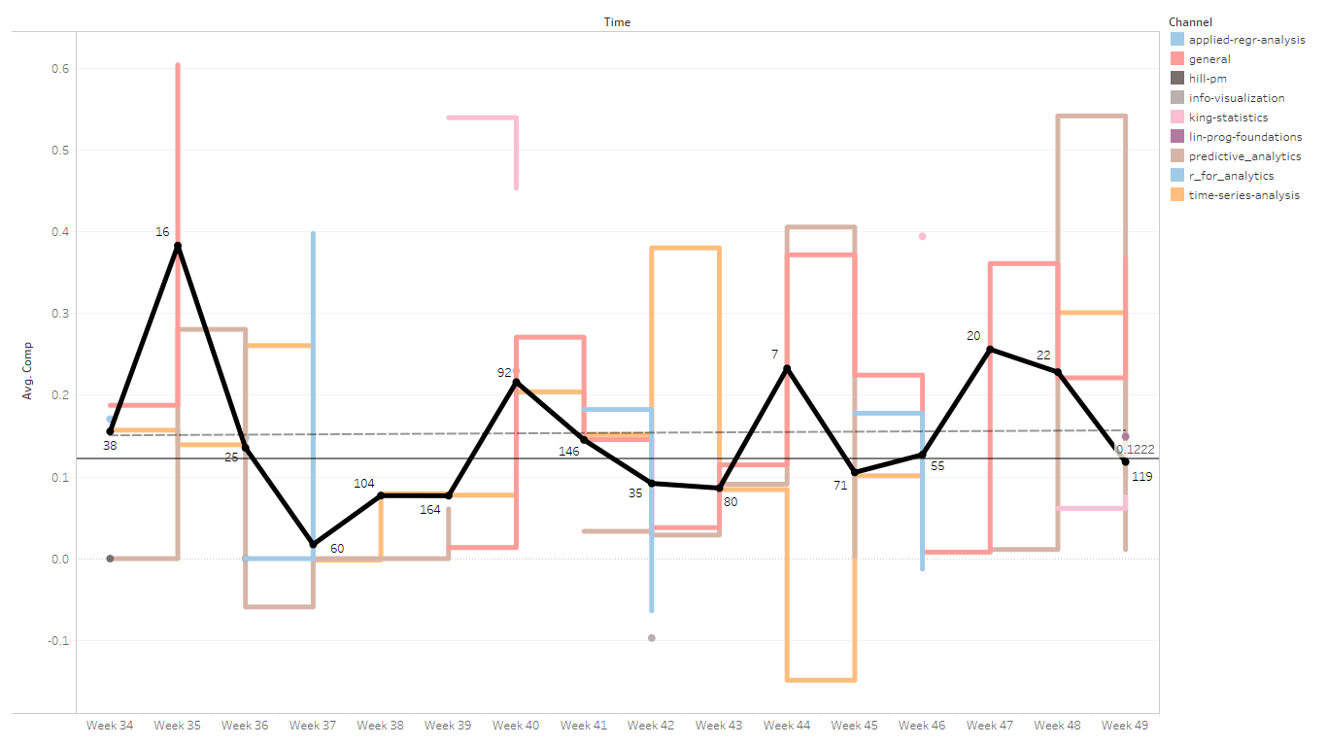
Sentiment Over Fall ’17 & ’18 Semesters
Collection
Data Preparation
Data Exploration
Data Analysis
Conclusions

Slide 21
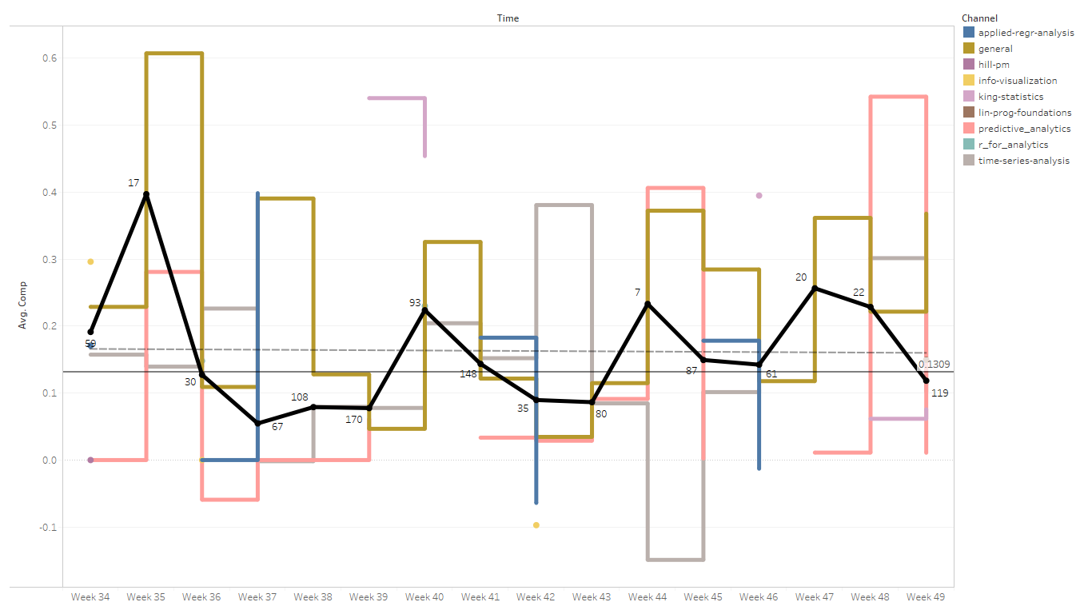
Sentiment Over Fall ‘17,’18, & ‘19 Semesters
Collection
Data Preparation
Data Exploration
Data Analysis
Conclusions

Slide 22
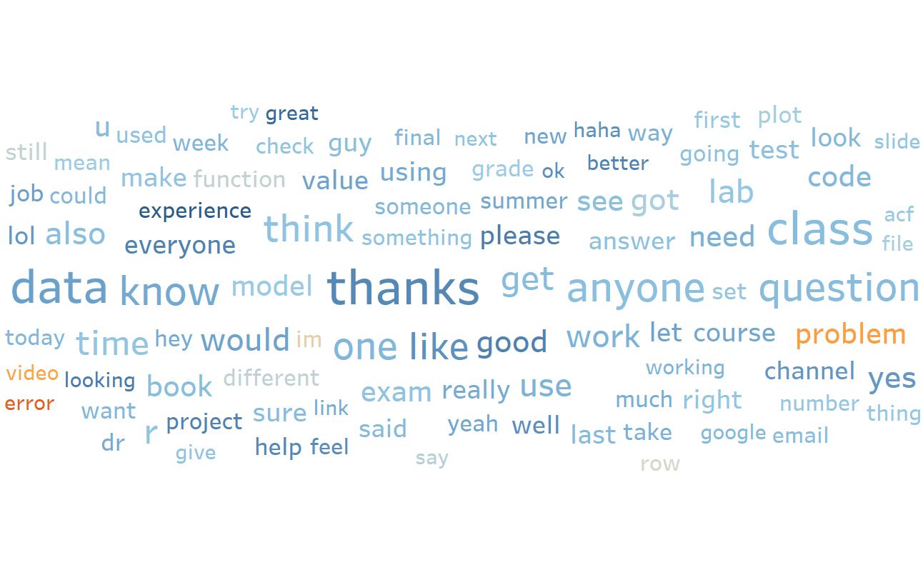

The 100 Most Used Words
Collection
Data Preparation
Data Exploration
Data Analysis
Conclusions
Frequency 47 - 284
Notes:
Talk about problem

Slide 23
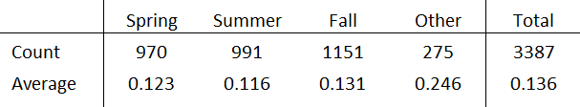
Conclusion
Collection
Data Preparation
Data Exploration
Data Analysis
- Overall sentiment is positive
- Sentiment will not change over time but has seasonal variation
- Variance is mostly in individual courses
- Summer is most negative
Conclusions

Slide 24
Future Work
- Real time sentiment analysis in each channel
- Professor involvement
- Continuation after I graduate

Slide 25
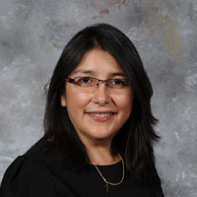
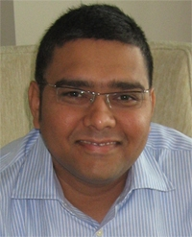
Acknowledgements
Dr. Ermelinda G. DeLaVina
Dr. Dvijesh J. Shastri
Armand Bendayan, Rebecca Crawford, Siddhartha Mamidanna, Jennifer Schleicher, and all the users of my workspace.

Slide 26
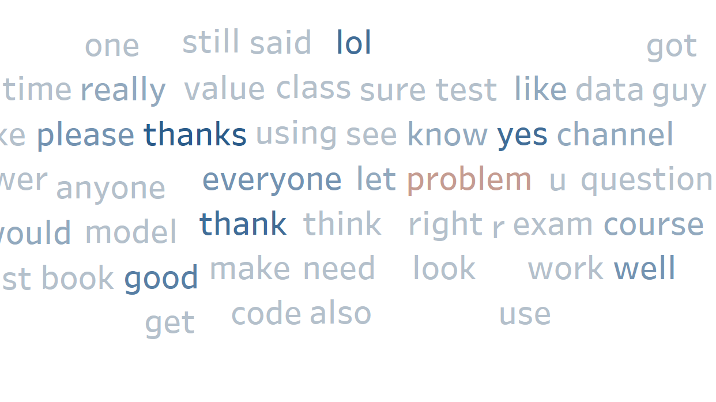

Questions?

